Slide 2
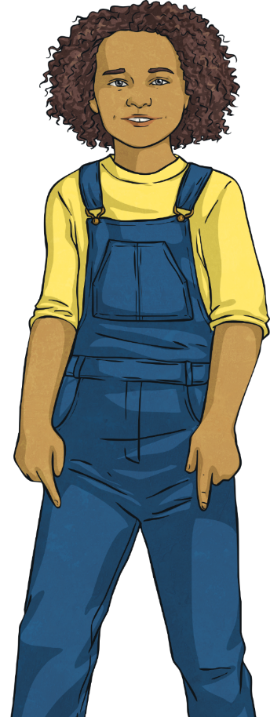
Puberty: What Happens to Girls?
Menstruation
You get taller and heavier.
Your bones grow bigger and heavier.
Hair grows under your armpits and around your genitals (pubic hair).
Your face changes shape.
Your voice gets a little deeper.
Your hips get wider and more curvy.
You start your periods.
Partner Talk – What examples can you think of?

Slide 3
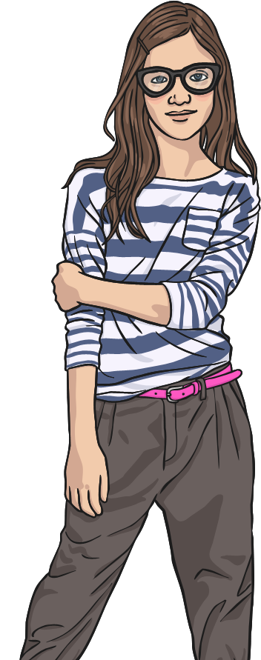
Puberty: What Happens to Girls?
Menstruation
Your body sweats more.
Your breasts and nipples get larger.
Your internal and external sex organs grow.
You may have mood swings, and sexual thoughts and feelings.
Your hair on your arms and legs grows darker.

Slide 4
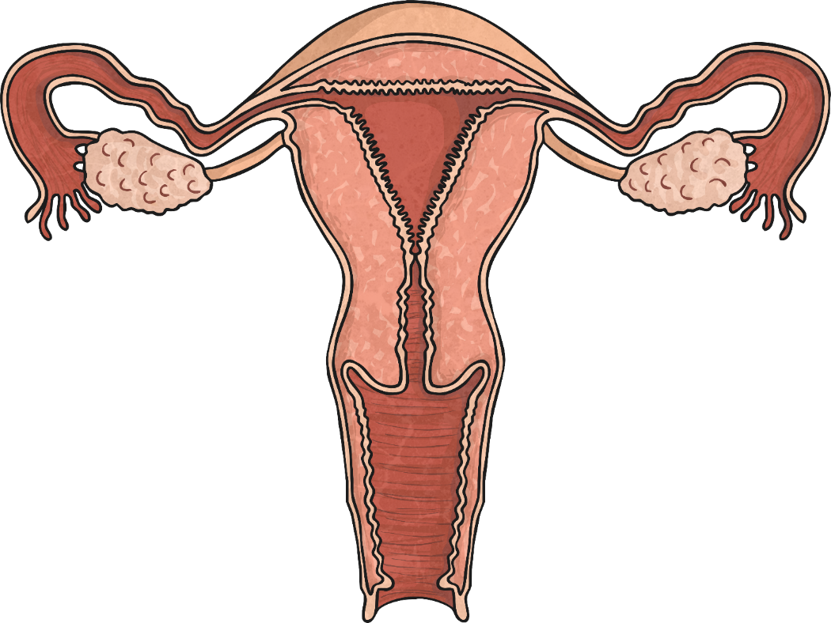
The Female Reproductive System
Menstruation
Fallopian Tube
Egg
Ovary
Uterus
Vagina
The opening of the female reproductive system.
Ovary
A pair of female reproductive organs in which eggs are produced.
Egg
A cell which is the beginning of a human embryo.
Uterus
A major organ where the human foetus develops.
Fallopian tube
The egg travels down the tube toward the uterus ready for fertilisation.
Click the points for more information.
Vagina

Slide 5
What Are Periods?
Menstruation
The egg moves from the ovary and along the fallopian tube and down into the uterus (womb).
Periods (menstruation) happen due to the hormones changing in your body.
When puberty is reached, an egg is released each month from her ovaries.
If the egg is not fertilised by a sperm, the lining of the uterus and the egg leaves your body through your vagina; this is called a ‘period’.
Even before birth, a girl has 1-2 million tiny eggs (ovum) in her ovaries.

Slide 6
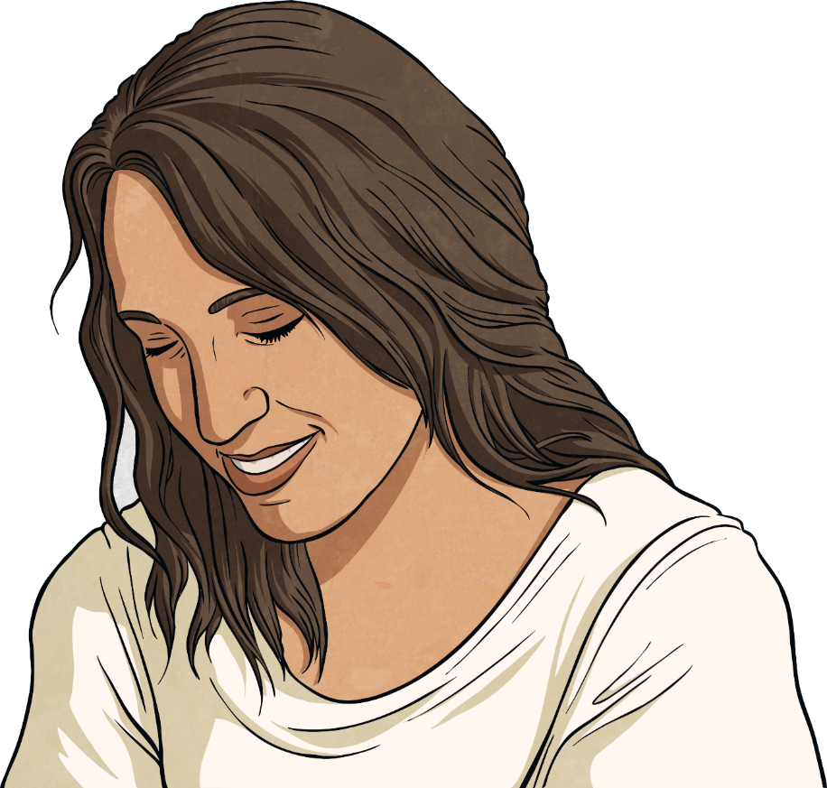
Why Do Periods Start
Menstruation
Periods are caused by hormone levels changing within your body.
Periods are a normal part of the female reproductive cycle.
It is nature’s way of preparing your body for having a baby when you are older.
They are nothing to feel embarrassed about.
Partner Talk – What questions do you have about periods?

Slide 7
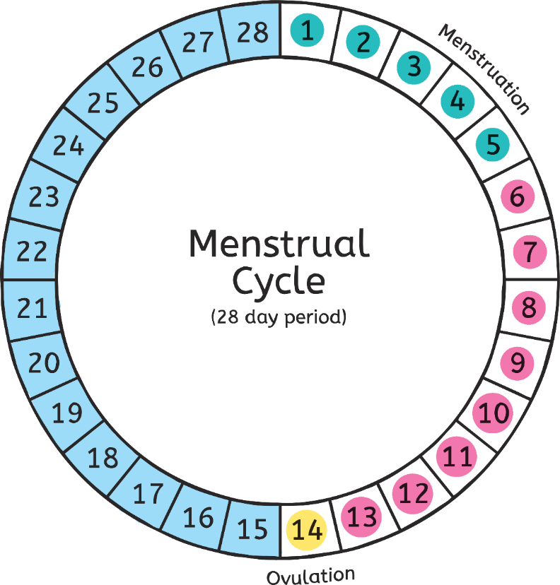
The Menstrual Cycle
Menstruation
The menstrual cycle is usually around 28 days. However, it can vary from between 23-35 days.

Slide 8
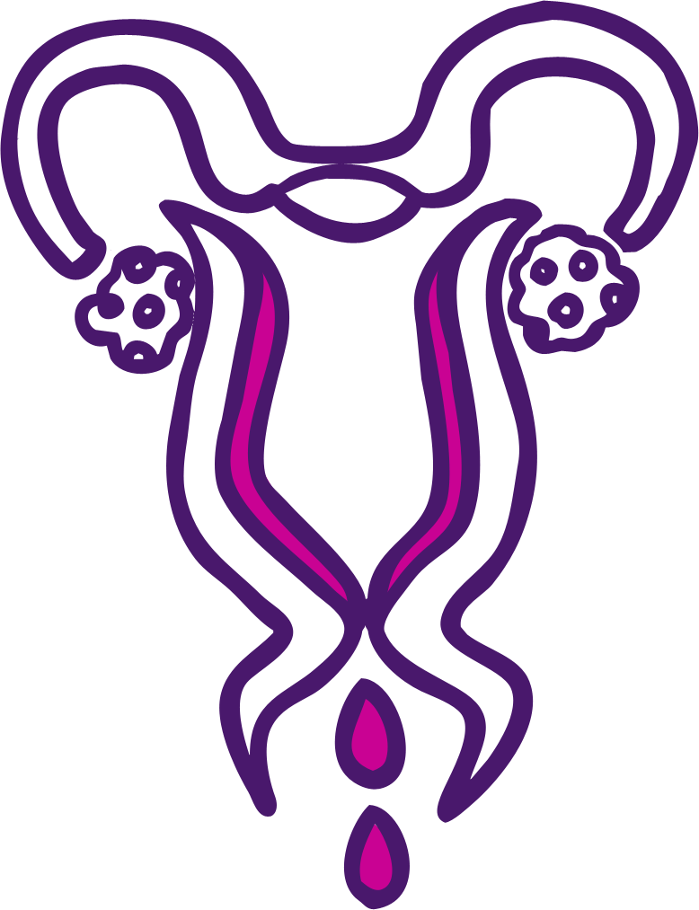
The Menstrual Cycle Days 1-5
Menstruation
Fallopian Tube
Ovary
Uterus
The lining is lost from the uterus.
This is called a period.
Vagina

Slide 9
The Menstrual Cycle Days 6-13
Menstruation
Fallopian Tube
Ovary
Uterus
The lining of the uterus thickens to be ready to receive an egg.
The egg will start to ripen on day 12.
Vagina

Slide 10
The Menstrual Cycle Day 14
Menstruation
Fallopian Tube
Ovary
When ripe, the egg is released from an ovary.
Uterus
This is called ovulation.
Vagina

Slide 11
The Menstrual Cycle Days 15-28
Menstruation
The lining of the uterus will stop developing if the egg is not fertilised.
The cycle will start again.

Slide 12
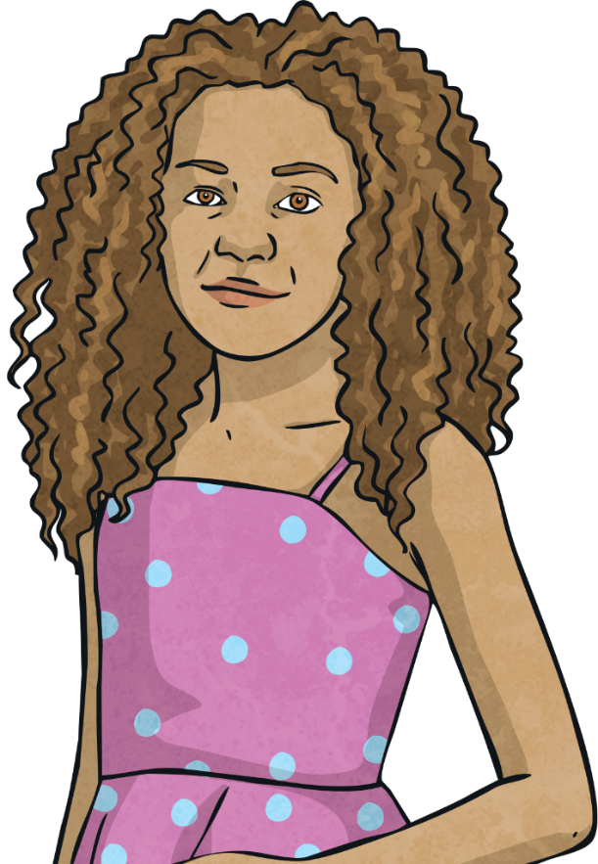
When Will My First Period Start?
Menstruation
Usually between 10 to 16 years old;
about 2 years after your breasts develop;
after you grow pubic hair;
after you start to notice
vaginal discharge.
Remember – Every girl is different!

Slide 13
What Symptoms Will You Have?
Menstruation
Many girls will experience PMS (Pre-Menstrual Syndrome). The symptoms can include:
tender breasts
feeling bloated
difficulty concentrating
stomach cramps
tiredness
mood swings
food cravings
headaches
spots
Partner Talk – What could you do to help ease some of these symptoms if they occur?

Slide 14
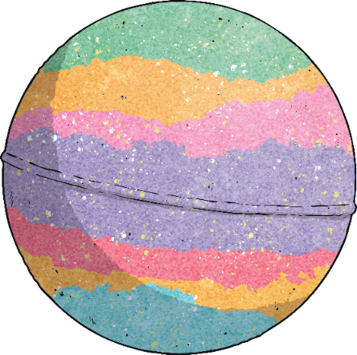
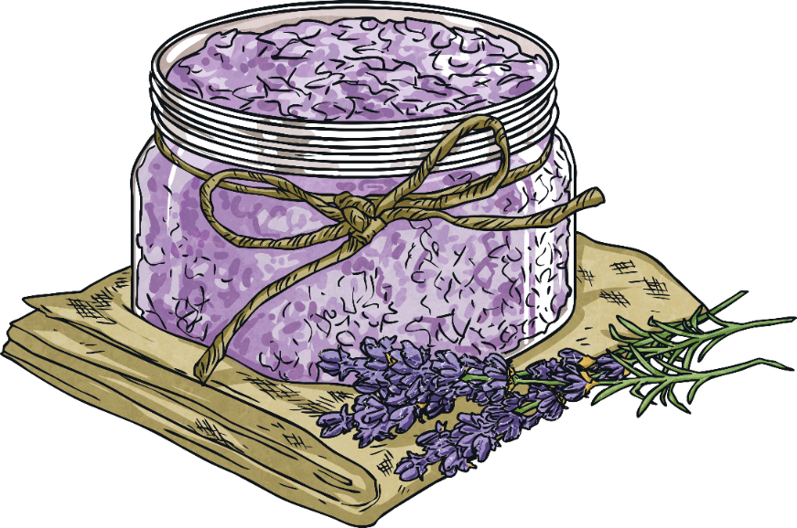
PMS - Things You Can Try!
Menstruation
Have a nice warm drink.
Eat a well balanced diet.
Take part in some gentle exercise.
Massage your stomach.
Use a hot water bottle or use a heat pad.
Have a warm bath.

Slide 15
During Your Period: What Happens?
Menstruation
Bleeding can last between 3 and 8 days.
The average blood loss is only around 80ml (roughly 3 tablespoons).
Your first period may be so light, you may not even realise that you are having one.
Blood flow may be heavier in the first few days.
Periods happen once a month but your body takes time to get into a routine so for the first year or so the time between each period may vary.

Slide 16
During Your Period: Feminine Protection
Menstruation
There are many different types of protection you can use during your period to absorb the blood and to stop it getting on to your clothes/underwear.
Some of the same products can also be used for vaginal discharge.
It is a personal choice and different for each girl. The most common type of protection are:
Sanitary towels
Tampons
Pantyliners
Partner Talk: What do you know already about the three types of feminine protection?

Slide 17
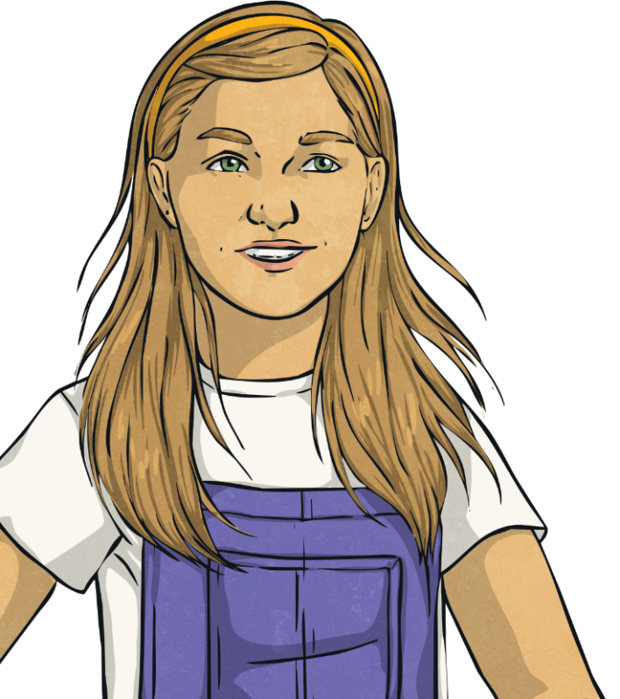
Pantyliners
Menstruation
These are worn outside your body in your underwear.
They are best used:
when your period is light;
in addition to a tampon;
in between periods to absorb discharge;
to help keep you fresh every day.
Partner Talk – What are the advantages and disadvantages of Pantyliners?

Slide 18
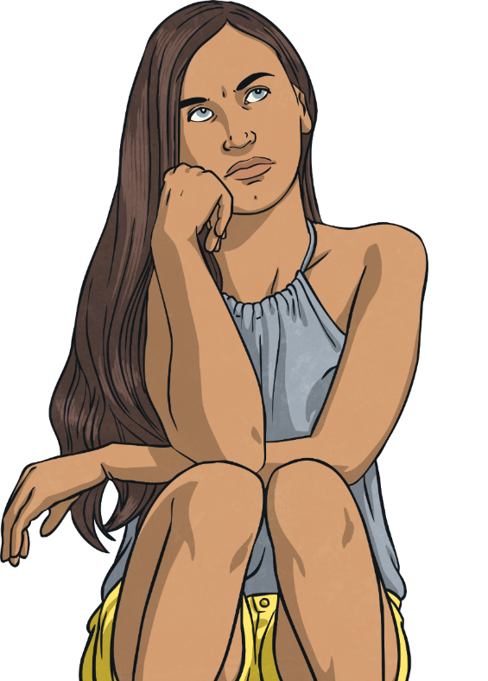
Sanitary Towels
Menstruation
These are worn outside your body in your underwear.
There are many different absorbencies depending on how heavy your period is.
Some have sticky tabs called ‘wings’, which help provide extra protection to the sides of your underwear.
They should be changed frequently to keep fresh and dry (generally every 4 to 6 hours but more often when your period is heavy).
Partner Talk – What are the advantages and disadvantages of sanitary towels?

Slide 19
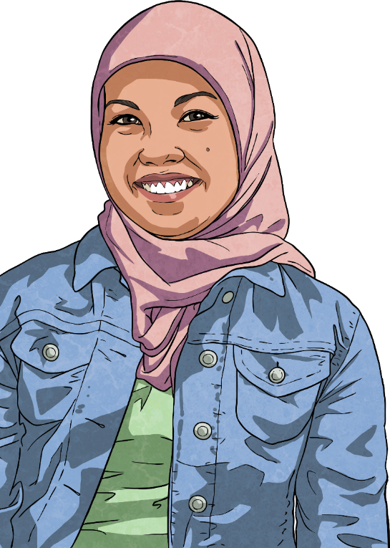
Tampons
Menstruation
These are worn inside your body in your vagina to absorb blood.
There are many different absorbencies depending on how heavy your period is.
Some come with an applicator to help when inserting them into the vagina.
They are good for swimming and other sports, such as gymnastics.
Should be changed regularly (every 4 to 8 hours but more often when your period is heavy).
Partner Talk – What are the advantages and disadvantages of tampons?

Slide 20
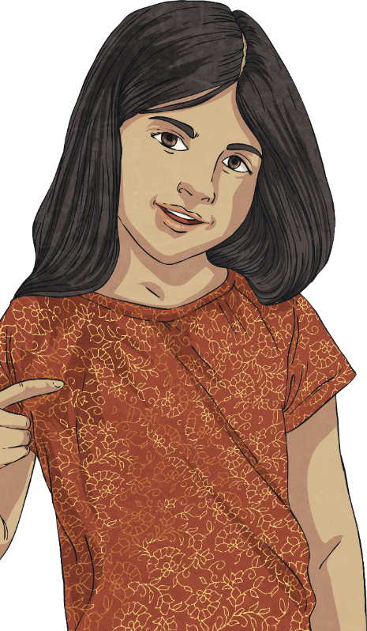
Period Pants
Menstruation
These are underwear with a pad built into the lining.
There are a range of pant styles available.
Each style holds a different amount of absorbency.
After use, the pants can be rinsed and washed like a normal item of clothing and then re-used.
Partner Talk – What are the advantages and disadvantages of period pants?

Slide 21
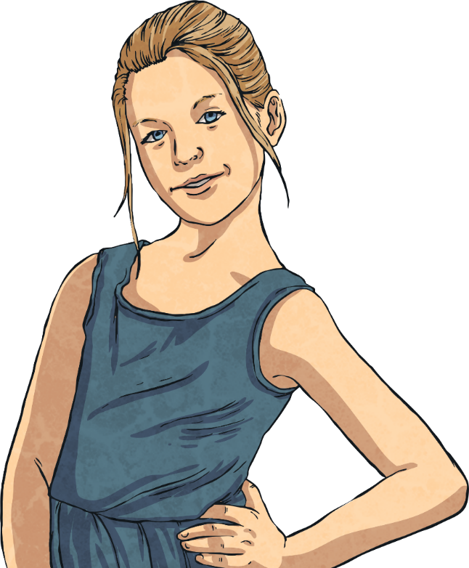
Menstrual cups
Menstruation
These are worn inside your body to collect blood.
These small, plastic cups are shaped like a bell and inserted into the vagina.
The cups have a stem to help insert and remove the cup.
They come in different sizes depending on how heavy your period is.
After 4 – 24 hours, depending on flow, the cups are removed, emptied, cleaned and re-used.
Partner Talk – What are the advantages and disadvantages of menstrual cups?

Slide 22
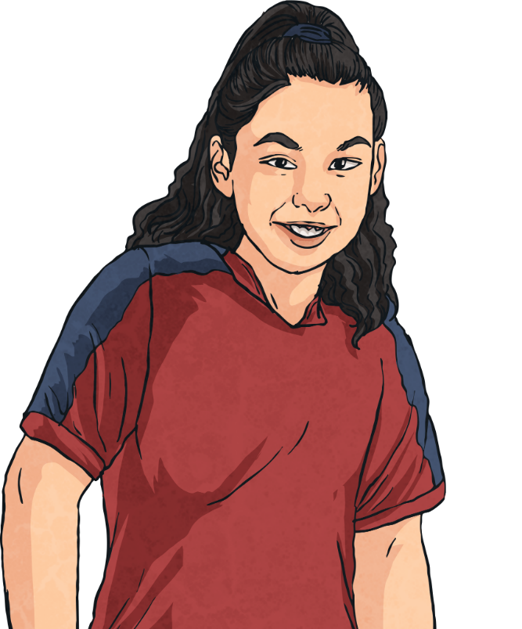
Re-useable pads and tampons
Menstruation
These are worn just like non re-useable ones.
These are washable cloth pads or sponge like tampons, which are used in exactly the same way as standard pads and tampons.
Both the pad and tampons can be washed and re-used which helps save money and the environment.
Partner Talk – What are the advantages and disadvantages of re-useable pads and tampons?

Slide 23
How Should You Dispose Of Your Feminine Protection Products Appropriately?
Menstruation
Some products are reusable so they don’t need to be disposed of. These include:
Period pants
Menstrual cups
Re-usable pads and tampons
Others are single use and should be disposed of after use. These products include:
Pantyliners
Sanitary towels
Tampons
It’s important that these products are disposed of appropriately. The most important rule with all of these single use products is simple, do not flush!
These products should be disposed of in sanitary bins or in ordinary bins if sanitary bins aren’t available. You can use the packaging from your new product to wrap up the used product before disposing of it or if it’s the end of your period, you may use some toilet tissue to wrap them up.

Slide 24
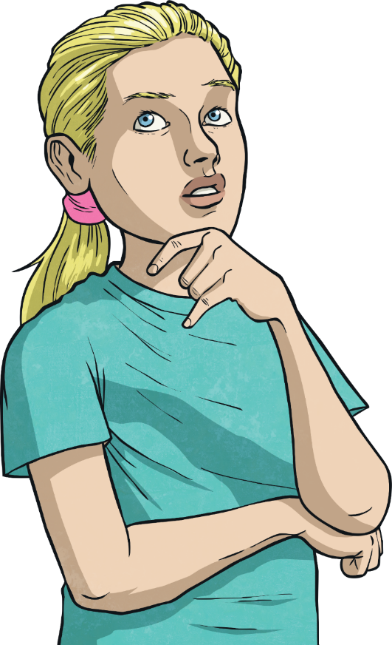
How Will I Know When My Period Will Start?
Menstruation
Mark on a calendar the date of your first period.
Count 28 days from the day of your first show of blood. This will give you a rough idea of when your next period will be.
Be prepared always carry some spare underwear and sanitary towels or tampons in your bag.
Let’s take a look at how to do this…
Remember: Periods will not have a set pattern in the beginning. They will eventually settle into their own pattern after a few months or years.

Slide 25
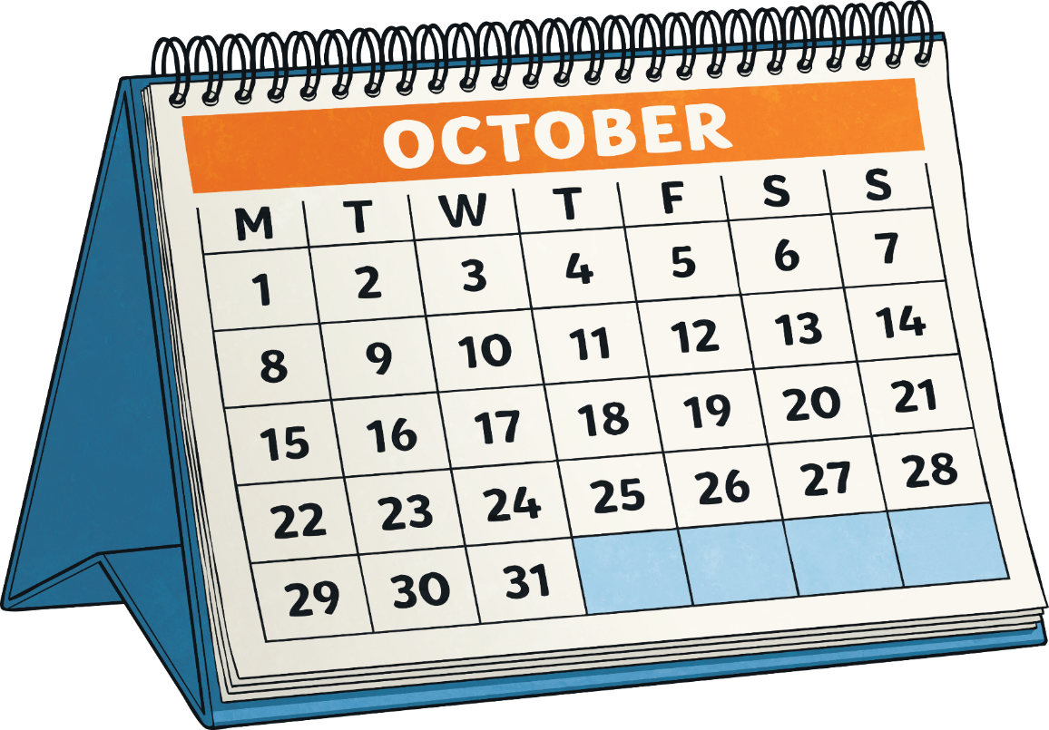
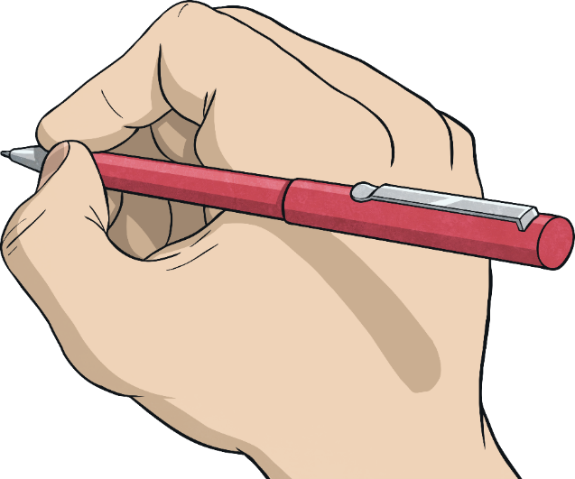
Working Out When Your Next Period Will Start
Menstruation

Slide 26
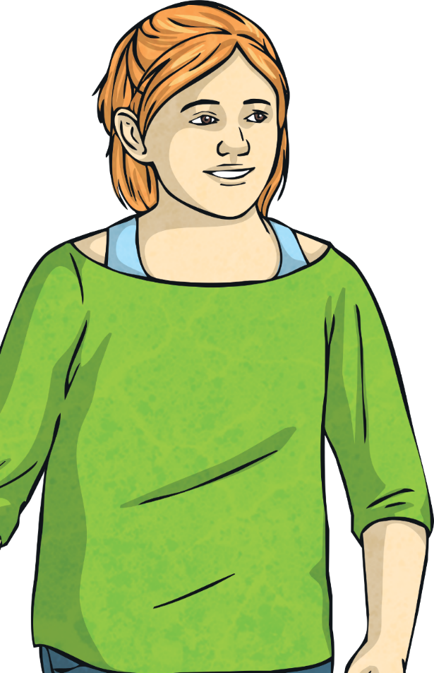
Remember
Menstruation
Having a period is a normal healthy thing to happen.
It is a natural process for every girl/teenager/woman.
It can take some time getting used to having periods and feeling confident about dealing with them.
Any question is a good question
Periods are a sign that your body is working properly; they are a special part of being a female.
Do you have any questions you would like to discuss?
Remember: no-one will know that you have your period, unless you tell them.

